Slide 1

Water Quality Assessment Procedures for Virginia: Dissolved Oxygen Assessment of Lakes and Reservoirs
Cayelan Carey & Whitney Woelmer
21 May 2020
Notes:
CCC

Slide 2
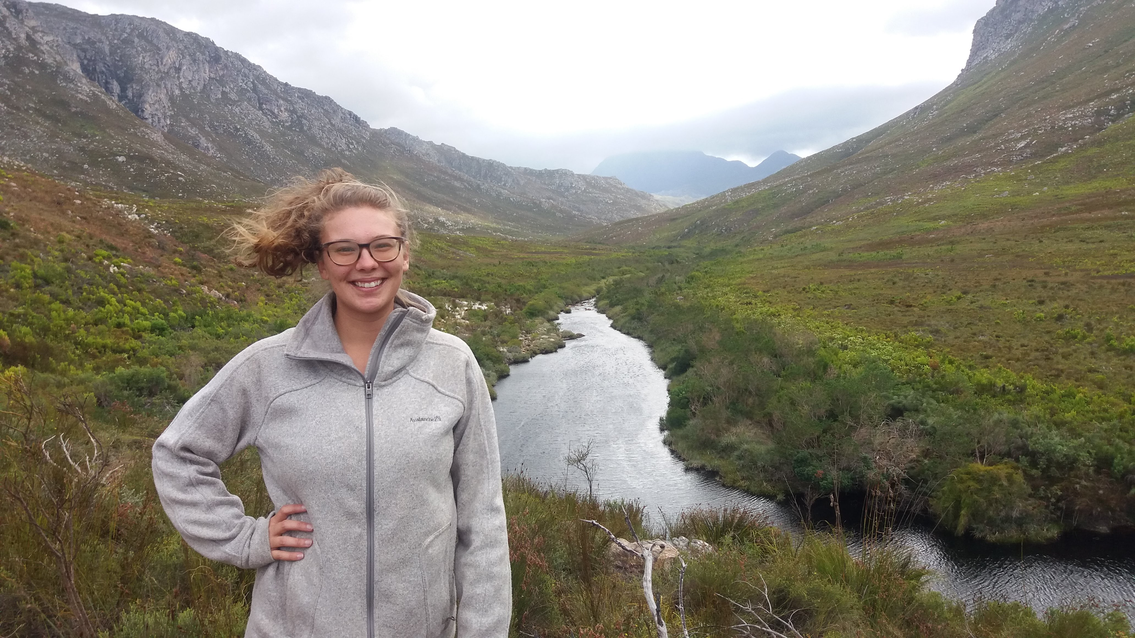
Background Expertise
Dr. Cayelan Carey, Associate Professor, Biology, VT
7 years as faculty at VT
Expertise focuses on drinking water monitoring and management
Works closely with Roanoke water utilities and oversees their monitoring program
Whitney Woelmer, PhD Student, Biology, VT
3 years at USGS studying Great Lakes food web and water quality dynamics
Extension Agent for Peace Corps Zambia managing fisheries and water quality for Department of Fisheries in rural Zambia
Notes:
CCC

Slide 3
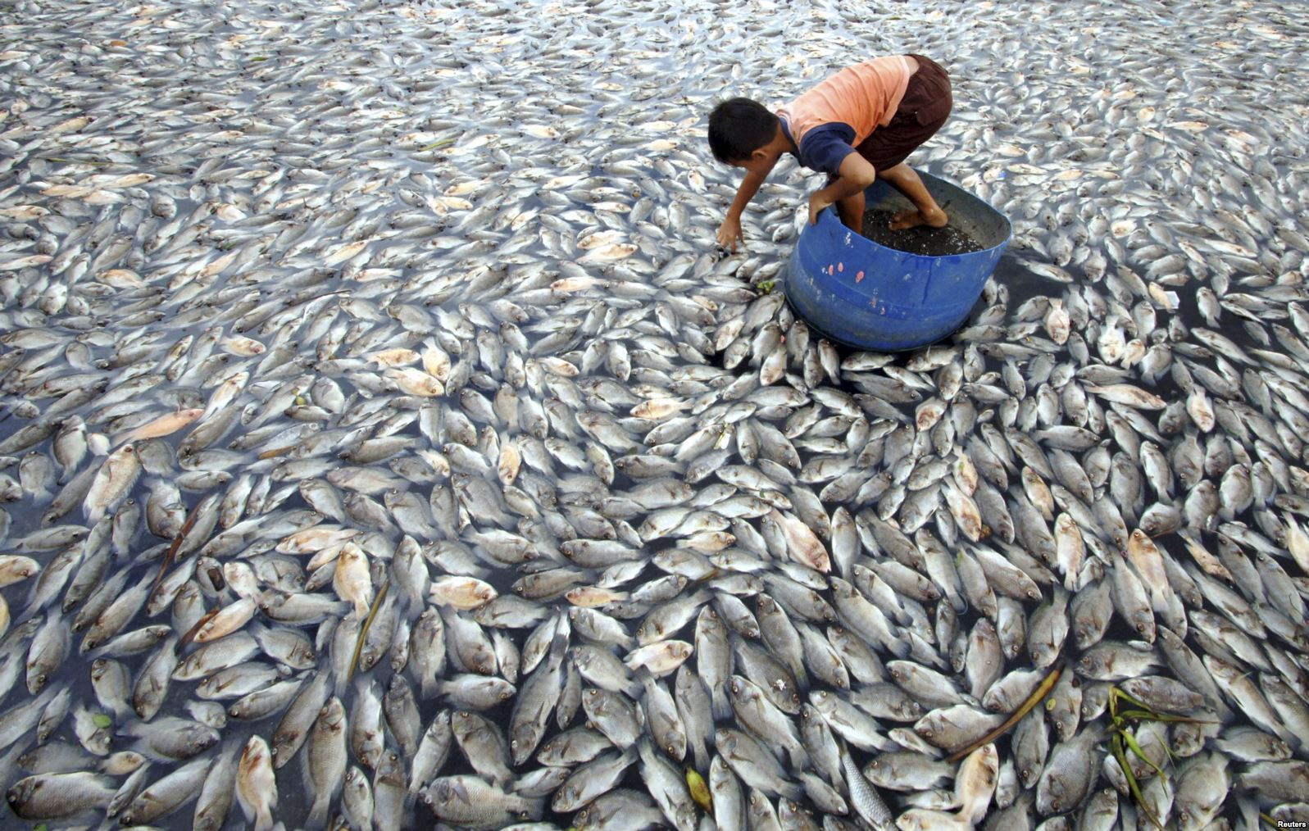
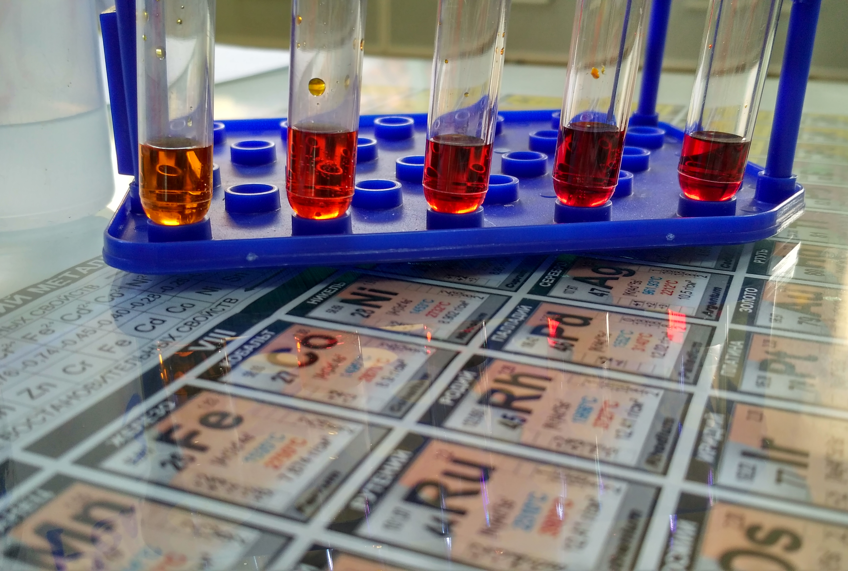
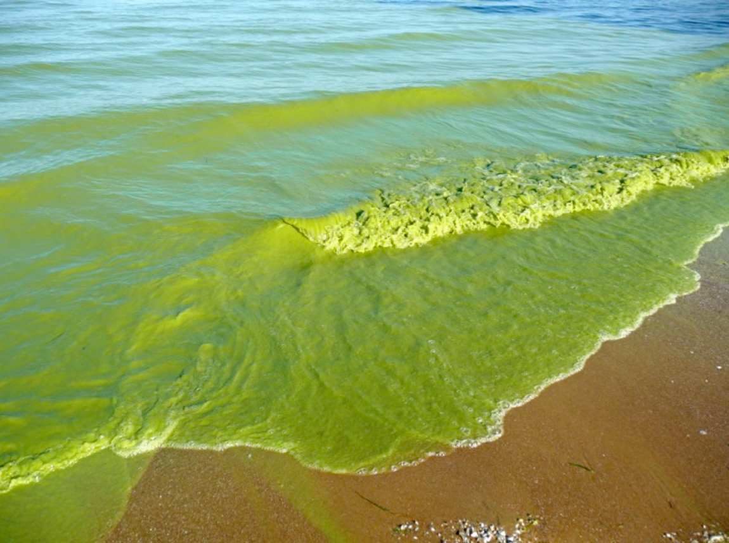
Dissolved oxygen (DO) is the most important metric of lake water quality
Governs the habitat and behavior of aquatic organisms
Promotes the release of nutrients and metals
Is an indicator of many ecological processes
Notes:
WW

Slide 4
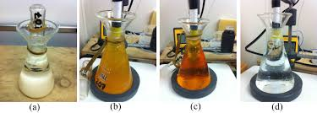
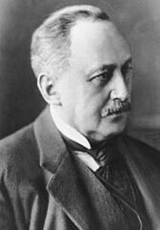
DO may be quantified as mg/L or % saturation
Winkler titration method developed in 1888 provides a mass concentration in mg/L
Previously, % saturation previously difficult to estimate
Now, % saturation is available on most handheld DO sensors, and has become a critically important metric by which to assess water quality
Notes:
WW maybe go into this here by first starting with something like 'DO was one of the first metrics to be measured by limnologists (an old picture of Winkler?), and was first done by the Winkler method, which provides a mass concentration, mg/L. Now that % saturation is much easier to measure and is on all handheld devices, it has became a critical metric by which to assess water quality. Then go into the differences and how temperature is related

Slide 5
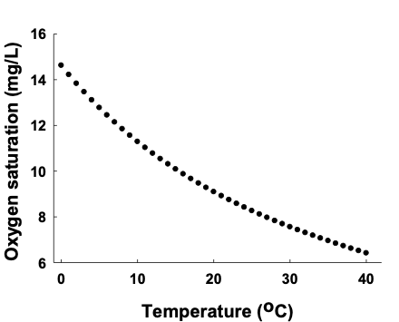
DO may be quantified as mg/L or % saturation
Percent saturation ranges from 0% (no oxygen present) to 100% (in equilibrium with atmospheric oxygen concentrations) to >100% (supersaturation)
Oxygen solubility increases with water temperature, so important to measure both when comparing DO conditions across waterbodies
This is especially important for year-round monitoring of waterbodies, which will exhibit varying temperatures
Notes:
WW The dotted line shows 100% saturation for each water temperature from 0 to 40 degrees Celsius.

Slide 6
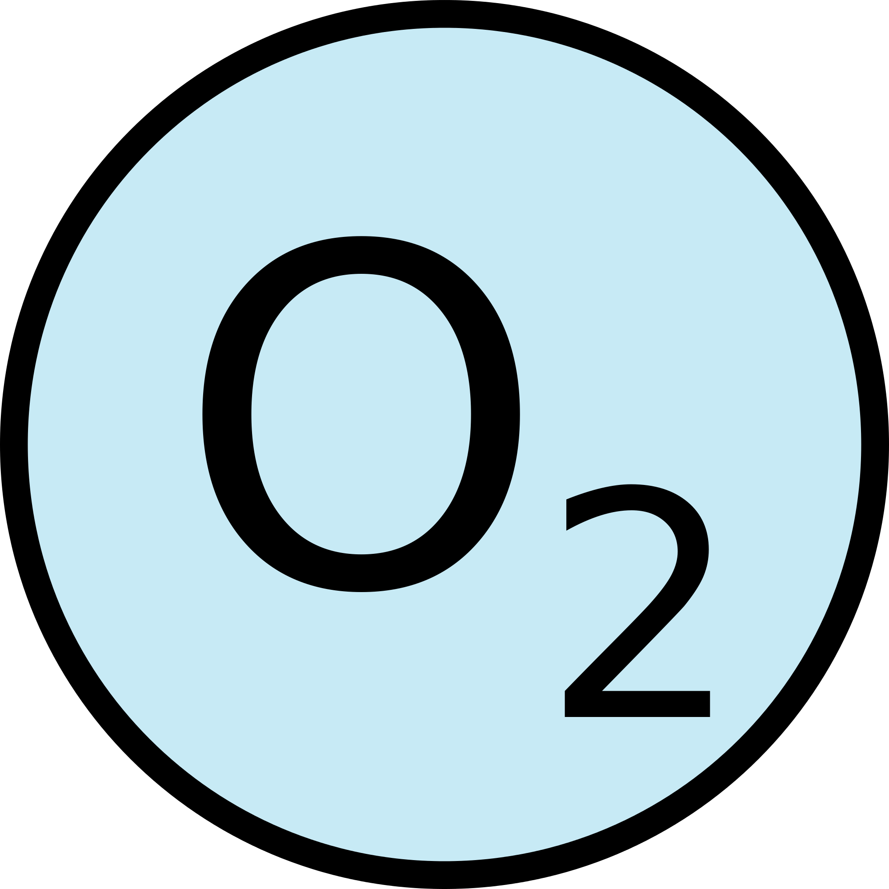




DO serves as a ‘gatekeeper’ for many ecological and biogeochemical processes
Atmospheric Exchange
Photosynthesis
Respiration
Decomposition
Notes:
WW Cayelan, this slide needs a lot more formatting work, which I didn’t want to spend too much time on yet before getting your feedback. The general flow would go something like this:
Different processes happen at different depletion levels, something about fish dying here
-DO is both a response and driver of many ecological and biogeochemical processes
-DO is usually high in surface waters due ot atmospheric exchange and photosynthetic production
-however, due to thermal stratification, reservoirs typically have distant thermal layers, epi and hypo, which do not fully mix. This often leads to much lower oxygen in the hypolimnion, as oxygen is used up for decomposition of organic material
-when oxygen is low in the hypolimnion, nutrients and heavy metals are often released from the sediment, which can then become mixed into the upper layers of the water column

Slide 7



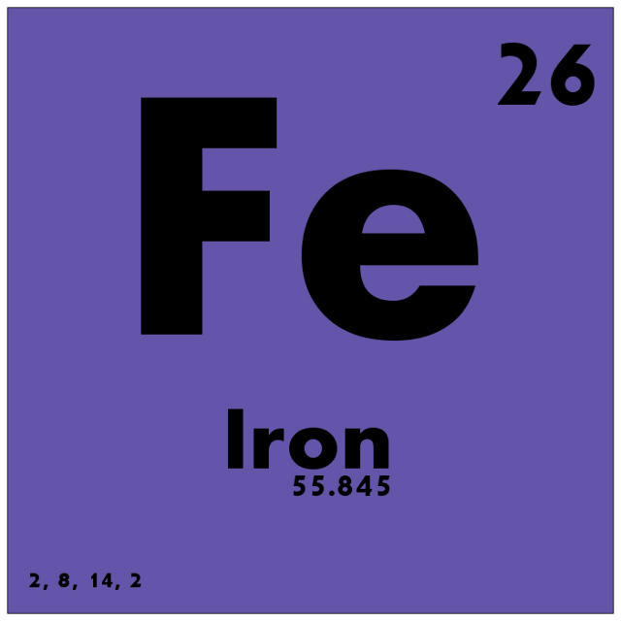

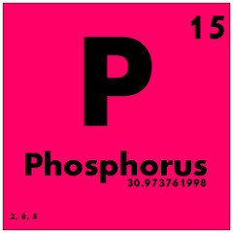
Different processes govern oxygen availability in stratified waterbodies
External Organic Material
Atmospheric Exchange
Epilimnion
Photosynthesis
Warm
Respiration
Low dissolved oxygen, hypoxia
Hypolimnion
Decomposition
Cold
Notes:
WW Cayelan, this slide needs a lot more formatting work, which I didn’t want to spend too much time on yet before getting your feedback. The general flow would go something like this:
-however, due to thermal stratification, reservoirs typically have distant thermal layers, epi and hypo, which do not fully mix. This often leads to much lower oxygen in the hypolimnion, as oxygen is used up for decomposition of organic material
-when oxygen is low in the hypolimnion, nutrients and heavy metals are often released from the sediment, which can then become mixed into the upper layers of the water column
-so while photosynthesis and atmospheric exchange can keep DO levels high in the epilimnion, processes such as decomposition and respiration of microbes dominate DO levels in the hypolimnion

Slide 8
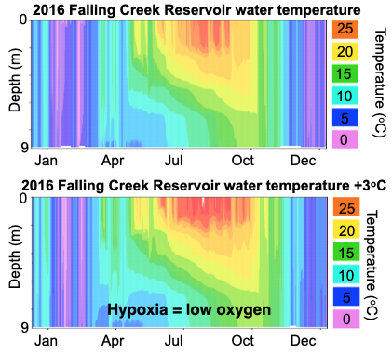
Thermal stratification patterns in lakes are changing globally, decreasing DO
Warmer air temperatures can lead to warmer surface water temperature, increasing the energy needed for fall turnover
Increases in salt pollution have prevented mixing, leading to incomplete or delayed fall turnover
Coupled with higher nutrient loading, hypolimnetic DO availability is decreasing in lakes and reservoirs globally
Jenny et al. 2016
Notes:
CCC

Slide 9
Reservoirs may be especially susceptible to global change effects
Large amounts of organic matter buried in sediments
Typically larger watershed area to surface area ratio, resulting in greater runoff of nutrients and salt pollution
Man-made impoundments typically located near large populations and at lower latitudes
In general, reservoirs are understudied, but their relevance to society means proper monitoring and management is critical
Doubek & Carey 2017, Thornton et al. 1990
Notes:
CCC

Slide 10
(1) Is DEQ’s current procedure for DO assessments in lakes/reservoirs sound and scientifically defensible? Does the AAC have any concerns about this procedure besides those already mentioned?
It is critical to assess DO in both the epilimnion and hypolimnion
Spatial monitoring of DO along the reservoir continuum (from the upstream to dam) provides valuable information
Temporal averaging should be done on short time scales, so as not to mask emerging patterns
The current DO threshold of 4.0 mg/L should be lowered to 3.0 mg/L
Notes:
CCC

Slide 11
(1) Is DEQ’s current procedure for DO assessments in lakes/reservoirs sound and scientifically defensible? Does the AAC have any concerns about this procedure besides those already mentioned?
The current DO threshold of 4.0 mg/L should be lowered to 3.0 mg/L
Virginia lakes range in temperature from 0 to >30ºC
Depending on temperature, 4.0 mg/L could range from 27-60% DO saturation, which encompasses both good (>50%) and poor (<50%) water quality
In comparison, 3.0 mg/L is consistently an indicator of poor water quality
3.0 mg/L is the EPA NLA threshold of “disturbed” water quality conditions
Using a 50% saturation threshold would be ideal, but we recognize that it may not be feasible for monitoring agencies to implement, especially given EPA’s precedent of using a mg/L threshold
Notes:
CCC

Slide 12
(2) Is the alternative procedure sound and scientifically defensible? Is it a substantively better approach than the current one? Do its advantages outweigh its disadvantages?
Three major concerns with alternative procedure:
It is critical to assess DO in both the epilimnion and hypolimnion
Spatial DO monitoring and individual assessment of sites along the reservoir continuum (from the upstream to dam) provides valuable information, without aggregation throughout the waterbody
Temporal averaging should be done on short time scales, so as not to mask emerging patterns occurring over 6 years
Notes:
CCC

Slide 13
(3) Is there another alternative approach that DEQ should consider?
At every current lake/reservoir assessment unit site, measure a full water column temperature and DO depth profile from the subsurface at 0.1 m on every meter interval to the nearest integer meter depth above the sediments. Dissolved oxygen should be measured in mg/L and percent saturation.
Establish the depth of the thermocline at that site, if it exists to delineate epilimnion and hypolimnion. If there is no temperature change between depths of at least 1ºC, then we propose treating the entire water column as one integrated layer for the steps below.
Notes:
WW

Slide 14
(3) Is there another alternative approach that DEQ should consider?
For each site individually, determine median DO concentration of the epilimnion. Exceedances within the epilimnion are defined as DO concentrations <3.0 mg/L.
For each site individually, determine the median DO concentration of the hypolimnion. Given the likelihood of DO depletion in the hypolimnion of most reservoirs that is inherent to their construction (see above), we further propose using the <3.0 mg/L threshold for hypolimnetic DO exceedances.
If there is no temperature change between depths of at least 1ºC, the entire water column should be treated as one layer. In this case, determine if the median DO concentration of the entire water column on a sampling day is below the DO exceedance threshold of 3.0 mg/L.
Notes:
WW

Slide 15
(3) Is there another alternative approach that DEQ should consider?
If there is more than one monitoring site within a lake/reservoir assessment spatial unit, aggregate epilimnetic DO concentrations among sites within a spatial unit. This aggregation should be calculated by taking the overall median of the median epilimnetic DO concentrations per site within each lake/reservoir assessment spatial unit for a sampling day.
If there is more than one monitoring site within a lake/reservoir assessment spatial unit, aggregate hypolimnetic DO concentrations among sites within a spatial unit. This aggregation should be calculated by taking the overall median of the median hypolimnetic DO concentrations per site within each lake/reservoir assessment spatial unit for a sampling day.
Notes:
WW

Slide 16
(3) Is there another alternative approach that DEQ should consider?
If either the median epilimnion or hypolimnion DO concentration of a lake/reservoir assessment spatial unit on a monitoring day is less than the 3.0 mg/L DO threshold, then that spatial unit as a whole is considered to exhibit an exceedance on that day. It would still be considered only one exceedance (not two exceedances) if both layers on the same day had median DO concentrations less than the threshold.
Notes:
WW

Slide 17
Example of determining exceedances within epilimnion and hypolimnion
Table 2. A hypothetical temperature and DO depth profile from a monitoring site.*
Depth | Temperature (degrees C) | DO (mg/L) | % DO saturation
0.1 | 28.0 | 7.8 | 100
1.0 | 27.5 | 7.7 Median: 7.7 | 98 Median: 97
2.0 | 27.0 | 7.7 | 96
3.0 | 26.5 | 7.6 | 95
4.0 | 18.0 | 5.8 | 61
5.0 | 16.0 | 5.5 | 56
6.0 | 15.0 | 5.2 Median: 5.2 | 52 Median: 52
7.0 | 14.0 | 2.3 | 22
8.0 | 13.0 | 1.6 | 15
Notes:
WW Example of determining thermocline and aggregating DO by epi and hypo

Slide 18
(3) Is there another alternative approach that DEQ should consider?
Calculate the total number of spatial unit-sampling days (i.e., the total number of days in which each spatial unit within a waterbody was sampled) over a maximum two-year rolling-window assessment period.
Notes:
WW

Slide 19
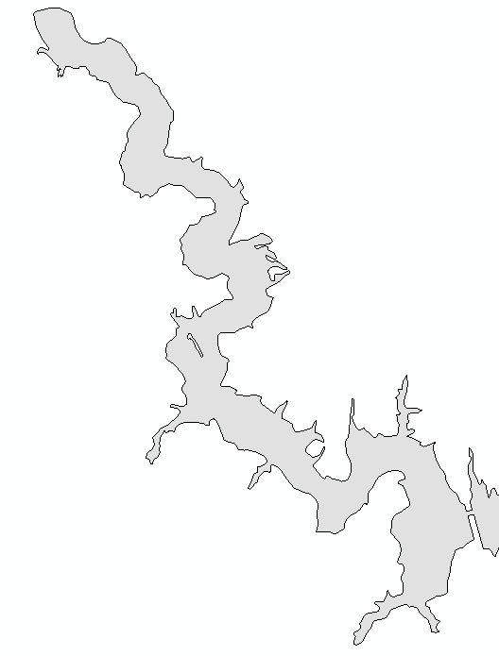
Example of exceedance calculation
Spatial Unit A (DEQ)
- 7 sampling days during 2-year period
- 1 day with either an epilimnetic or hypolimnetic DO exceedance
Spatial Unit B (Non-Agency)
- 4 sampling days during 2-year period
- 0 days with either an epilimnetic or hypolimnetic exceedance
DO Assessment Summary
7 + 4 + 12 = 23 spatial unit-sampling days
1 + 0 + 1 = 2 days with epilimnetic or hypolimnetic exceedances
Exceedance rate = 2/23 = 8.7%<=Criterion Attained
Spatial Unit C (DEQ)
- 12 sampling days during 2-year period
- 1 days with either an epilimnetic or hypolimnetic DO exceedance
Notes:
CCC For example, if there were three spatial units within one lake and each were measured on 7, 4, and 12 sampling days, respectively, over two years, then there would be 23 total spatial unit-sampling days in that two-year assessment period. The exceedance rate is then calculated as the number of times in which any sampling site exhibited an exceedance over the total number of spatial unit-sampling days (see Figure 3 as an example).

Slide 20
(3) Is there another alternative approach that DEQ should consider?
A waterbody is considered impaired for DO if the exceedance rate is >10% for the two-year assessment rolling-window period.
For calculating descriptive statistics in additional DEQ reports, aggregate data first to calculate month-medians prior to additional analyses vs. pooling all data equally within a year.
Notes:
WW

Slide 21
(4) Should DEQ restrict DO assessments to vertical profile datasets in lakes/reservoirs or is it appropriate for a surface-only DO dataset to form the basis of an assessment for a lake/reservoir? If the latter, how should surface-only data (or data from shallow profiles) be used in assessments?
It is critical that a full water column profile be used for DO water quality assessment, so we strongly recommend against using a surface-only DO dataset.
As described earlier, we propose a modified DO threshold for both the epilimnion and hypolimnion (<3.0 mg/L), which follows the EPA’s threshold for categorizing water quality (U.S. EPA 2017).
Notes:
CCC

Slide 22
(5) Can the AAC recommend a set of instructions that staff could use 1) to determine whether exceedances at a station are due solely to incomplete fall turnover?
A determination of whether incomplete fall turnover has occurred could be made using a time series analysis.
Assess the magnitude of thermal stratification, recent air temperature patterns, differences in DO between the epi- and hypolimnion
If water temperature differences between the hypolimnion and epilimnion are still >1°C, it is likely that fall turnover is incomplete or has not yet occurred. This result would necessitate additional sampling events into later autumn to determine if fall turnover was actually incomplete or merely delayed.
Our proposed new sampling protocol would capture the distribution of DO concentrations between the two water layers, rather than only showing a decrease in DO in the epilimnion during incomplete turnover
Notes:
WW

Slide 23
(5) Can the AAC recommend a set of instructions that staff could use 2) to determine to what degree low DO during fall turnover might be exacerbated by pollution?
Low DO conditions during incomplete fall turnover are often related to pollution from nutrients (nitrogen and/or phosphorus) and/or salt.
High ratio of watershed area to reservoir surface area, reservoirs often receive a substantial amount of runoff
Historical eutrophication of waterbodies was common throughout Virginia, hypolimnetic anoxia can promote their release years after the nutrients entered the waterbody
Given that historical pollution can potentially have long-term effects on current DO conditions, a detailed time series of the waterbody's pollution record is needed to disentangle the relative effects of current pollution on a waterbody
Notes:
WW

Slide 24
(5) Can the AAC recommend a set of instructions that staff could use 3) to downweight fall turnover DO data while still being protective of living resources?
Dissolved oxygen concentrations are important to aquatic life throughout the year, so we do not recommend down-weighting low DO concentrations in the autumn months
Low DO conditions can promote the release of nutrients and metals from the sediments into the water column, further exacerbating poor water quality, which should be monitored and reported.
Thus, it is critical that DO availability throughout the year be included in lake/reservoir water quality assessments.
Notes:
CCC

Slide 25
We welcome questions and feedback on the proposed protocol Thank you!
Notes:
CCC

Slide 27
Current Procedure
DEQ staff pool data by taking all measurements taken in the epilimnion (for Section 187 lakes/reservoirs) or in the water column (for non-Section 187 lakes or when Section 187 lakes/reservoirs are not stratified) over the six-year assessment period
Epilimnetic samples are then compared to the minimum DO criterion (4.0 mg/l for most lakes/reservoirs). If more than 10% of these samples are below the criterion, then the lake/reservoir assessment unit will be deemed impaired for DO.

Slide 28
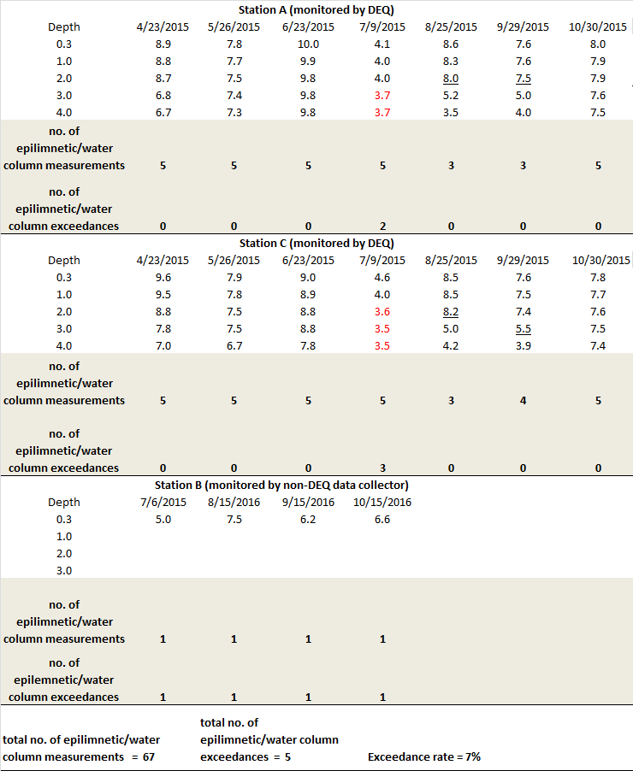
Notes:
Red values are DO criterion exceedance (< 4.0 mg/l).

Slide 29
Alternative procedure:
One alternative procedure would begin by establishing the location of the thermocline at an individual station (the point where the temperature change between depths is > 1˚C), as is done currently.
Epilimnetic or water column DO samples along the vertical profile would then be aggregated via the median. This would represent the average DO at this station, but in a way that does not presume how the samples are distributed or allow outlier samples to have undue influence.
The next step would be the aggregation of all “epilimnon/water column medians” generated at stations visited during the same monitoring run. A median would again be used for the same reasons as above. The end result would be a snapshot of a water body’s DO concentration for a particular monitoring run.
The end result would be an exceedance rate that could be reasonably interpreted as “Aquatic life had unsuitable habitat X% of the time when the lake/reservoir was monitored.” This exceedance rate would then be evaluated against the 10% rule to determine criteria attainment status for the lake/reservoir assessment unit.

Slide 30
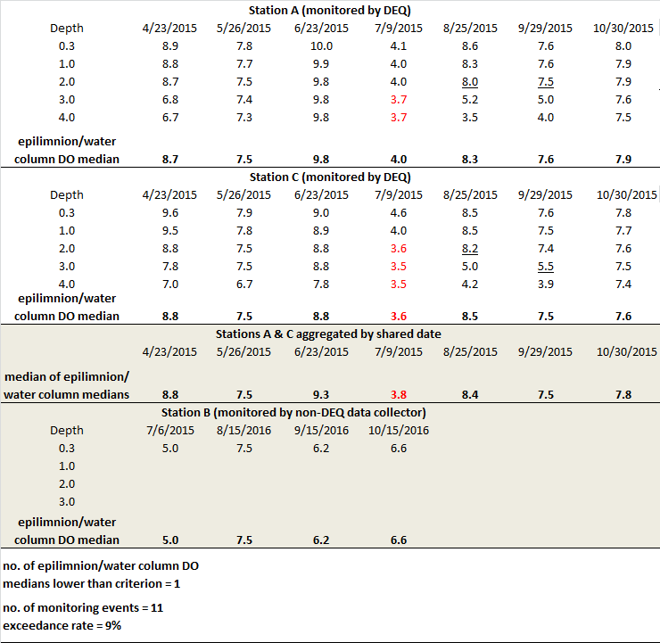

Slide 31
Concerns with this approach
Only epilimnetic measurements
Only mg/L used, not % saturation
Massive spatial averaging within a profile, over time, and among spatial units
Aggregation over 6-year time span could mask water quality changes

